Slide 1
Recommendations for Reviewers, Editors, and Authors in Systematic Reviews and Meta-Analyses
Ernest H. O’Boyle
Justin A. DeSimone
Michael T. Brannick
Ji Woon (June) Ryu
February 1, 2019

Slide 2
Need for Transparency
Replication crisis in social science (Hunter, 2001; Ioannidis, 2005a; Ioannidis, 2005b)
Call for transparency across all areas of scholarship (Christensen & Miguel, 2017; Nosek et al., 2015)
Authors focused on research synthesis and meta-analysis are among the greatest proponents of transparent reporting (APA; 2008; Aytug et al., 2012; Moher et al., 2009)

Slide 3
Transparency in Meta-analysis
Judgment calls (Aguinis et al., 2011; Geyskins et al., 2009; Wanous et al., 1989)
Lack of transparency in reporting judgment calls can lead to difficulty in interpreting meta-analytic results (Carlson & Ji, 2011; DeSimone et al., in press)
A lack of transparency can lead to confusing or conflicting results (Bobko & Stone-Romero, 1998; Ioannidis, 2016; Van Iddekinge et al., 2012)

Slide 4
This Presentation
Identify best practices and areas for improvement in reporting meta-analytic methodology and results
Focus on areas that are particularly relevant or unique to the field of management
Organized into three sections
Search and Coding
Data
Analysis
Encourage authors, editors, reviewers, and readers to follow and demand transparent reporting practices in systematic reviews and meta-analyses

Slide 5
Reporting Issues in Search and Coding
Management is multidisciplinary by nature
Management borrows ideas from a diverse set of disciplines
Meta-analyses in management often require searching multiple databases
Transparent documentation:
Construct definition and scope
Databases
Keywords (and combinations)
Intentional omissions

Slide 6
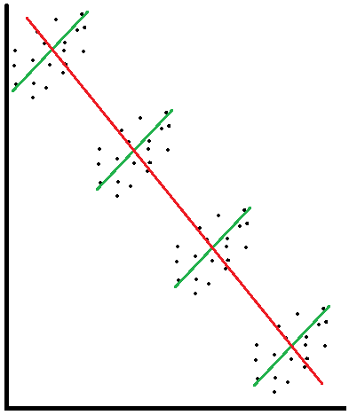
Construct Clarity
Context plays an important role in identifying boundary conditions for many management theories
Some constructs in management exist at different levels
They may be conceptualized and operationalized in different ways
Clear definitions of constructs and inclusion/exclusion criteria can help avoid confusion or misinterpretation (e.g., ecological fallacy)
Consider context when reporting inclusion criteria
Anticipate potential misperception by readers

Slide 7
Inclusion and Exclusion Criteria
Existing reporting standards and best practices (e.g., MARS, PRISMA) ask meta-analysts to carefully detail decision rules and inclusion/exclusion criteria
Most meta-analyses in management use the Hunter & Schmidt procedure (Aguinis et al., 2011)
Favors inclusion over scrutiny of primary study quality
Document efforts to find unpublished studies, a priori quality standards (Slavin, 1986; 1995), and decision rules or cutoffs

Slide 8
Specify Decision Rules
Construct definitions and constraints
Inclusion/exclusion criteria
Order of application
Limits, cutoffs, and boundary conditions

Slide 9
Meta-Analysis Reporting Standards - Data
CARMA Feb 2019

Slide 10
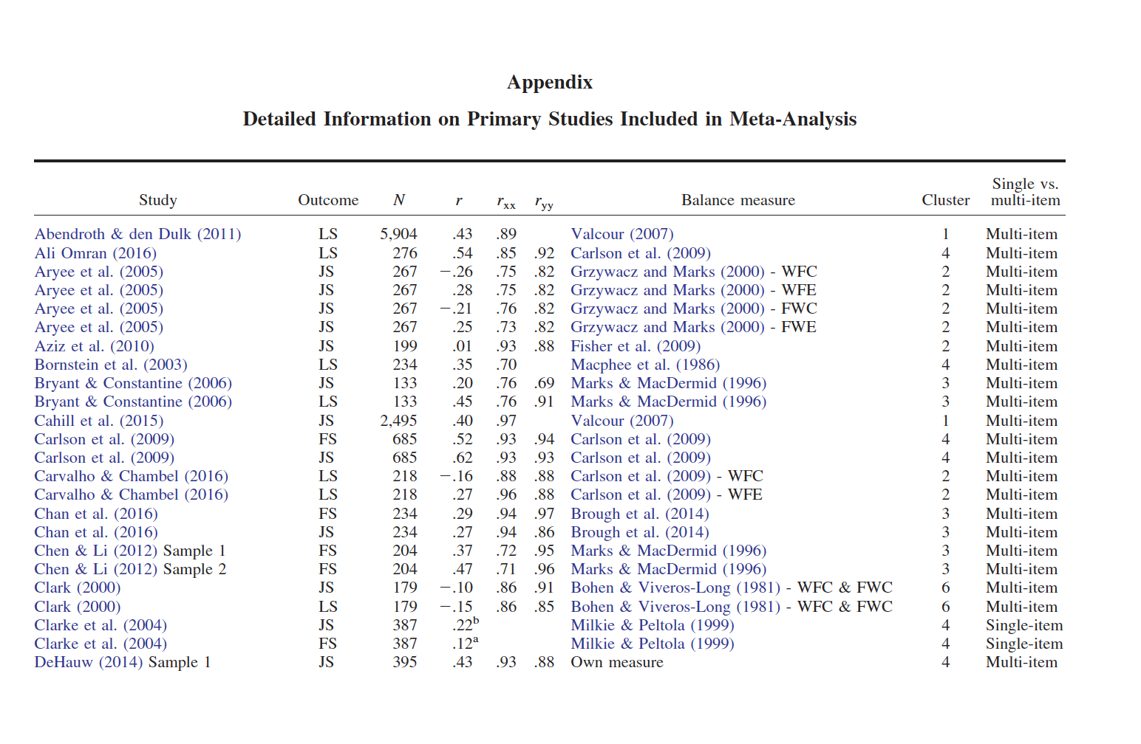
Data Distribution – Report the Data
Transparency
Error checking
New methods
Updates (new meta)
Casper et al. (2018). The jingle-jangle of work-nonwork balance: A comprehensive and meta-analytic review of its meaning and measurement. Journal of Applied Psychology, 103, 182-214.

Slide 11
Dependent Effect Sizes
Within Studies – Same People
Multiple times (e.g., pre-post)
Multiple measures
Multiple conditions
Between Studies
Multiple reports of same study
Partial overlap between studies
Same sample, different authors
New meta contains old meta as one estimate; overlap in data
Mturk or similar where people may volunteer for multiple studies
Identify dependencies in data.
Describe how you addressed them.

Slide 12
Effect Size Distribution – Visual displays
Forest plots – good if there are few studies
Can show outliers
Notes
Sorted by effect size
RE summary of each level (definition of balance)
Cluster 2 has extreme range. Coding?
Prediction interval (95% PI) at bottom with overall estimate

Slide 13
Funnel Plot & Availability Bias
Good if large number of studies
Quick look for bias, outliers, heterogeneity
Notes
If homogeneous, most dots inside white space
Huge heterogeneity in these data
No obvious association between ES & N (availability)
Streaks indicate dependent ES

Slide 14
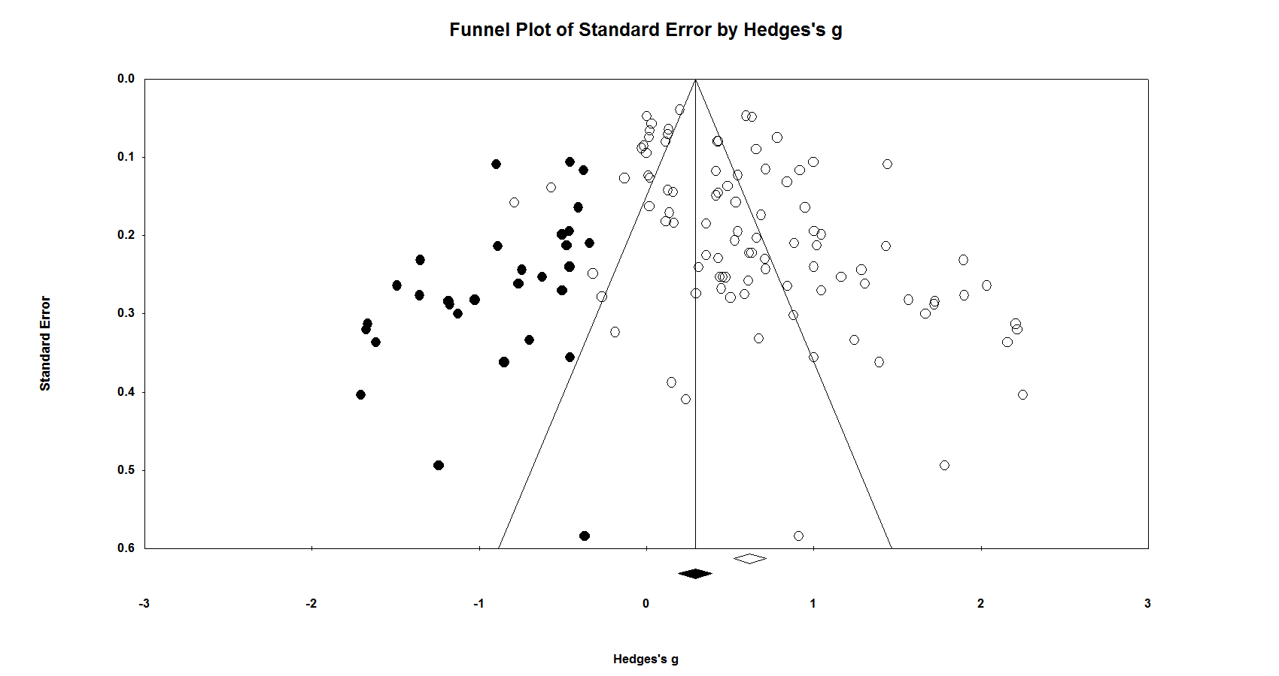
Trim & Fill
Effects of Educational Innovations on Learning Outcomes
Note that the smaller studies show larger effect sizes (open dots)
Imputed studies by trim & fill algorithm are filled in black
Note the difference in the overall estimates
Other methods may be superior for this purpose

Slide 15
Effect Size Conversions
Nature and Number of Conversions
Describe choices and rationale
Sensitivity Analysis
Impact of study type that required conversion

Slide 16
Reporting issues in the analysis

Slide 17
Software
A lot of variety in software packages
Some like R’s metafor package are very flexible and can recreate the results from other software packages (e.g., CMA), but depending on settings, you can get different results (e.g., tau, SD-rho)
Increasingly, a lot of options in these programs
Need for the reporting of estimators, thresholds used, etc.

Slide 18
Bivariate Results
Hunter-Schmidt (psychometric MA) has been dominant paradigm in IO/MGMT
Corrected and uncorrected estimates
report the standard deviation and standard error of observed and corrected summary effect sizes.
These values are relevant to heterogeneity and meta-analytic moderation
Corrections used
Type(s) of reliability corrected for
Type/case of range restriction (if applicable)
other artifacts corrected for
Whether the corrections were computed based on data reported in the primary study or through artifact distributions
Order of corrections

Slide 19
Multivariate Results
Increasingly common to combine Hunter-Schmidt with Lipsey-Wilson to conduct meta-regression/meta-ANOVA
Not going to discuss the appropriateness of these combinations, just the reporting of their use
Same goes for MASEM.

Slide 20
Meta-Regression/Meta-ANOVA
How weight for artifact-corrected effect sizes were determined
Whether meta-regression run on corrected or uncorrected effect sizes
Whether assumptions were met/common sense employed
Scatterplots
Examination of the residuals
Number of included studies in each category

Slide 21
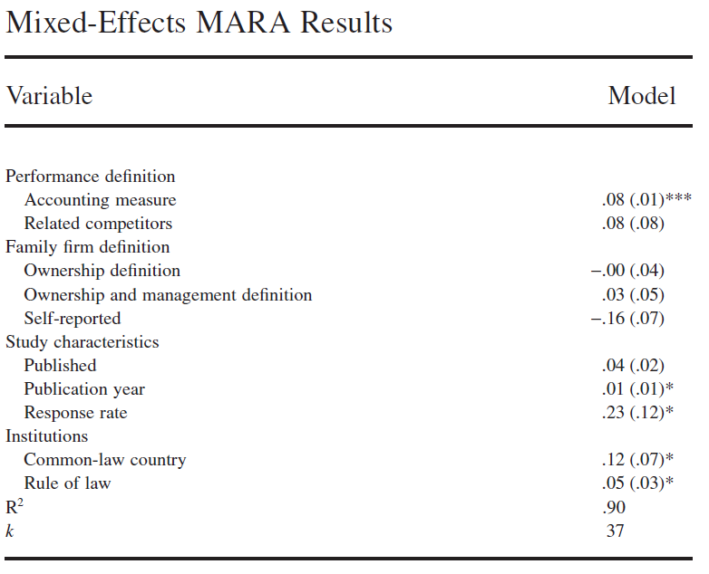
Meta-regression is not immune to regression violations
96% of data from Norway

Slide 22
MASEM
MAs in management routinely combine population estimates from prior MAs with their own findings to test complex models
Report choice of which past MA to use
Discuss the independence and comparability of samples across multiple MAs
Justify the appropriateness of combining meta-analytic findings, as different MAs may have relied on more or less relevant inclusion criteria
Degree of effect size heterogeneity and the specific procedures used
How large were the SD-rho?
How many elements in the correlation matrices were missing
Did it meet MCAR/MAR assumptions?

